Slide 1

Priority Queues
© 2013 Goodrich, Tamassia, Goldwasser
Priority Queues
Notes:
Priority Queues

Slide 2
Priority Queue ADT
A priority queue stores a collection of items
Each item is a pair
(key, value)
Main methods of the Priority Queue ADT
  add (k, x)
  inserts an item with key k and value x
  remove_min()
  removes and returns the item with smallest key
Additional methods
  min()
  returns, but does not remove, an item with smallest key
  len(P), is_empty()
Applications:
  Standby flyers
  Auctions
  Job scheduler in Operating systems
© 2013 Goodrich, Tamassia, Goldwasser
Priority Queues

Slide 3
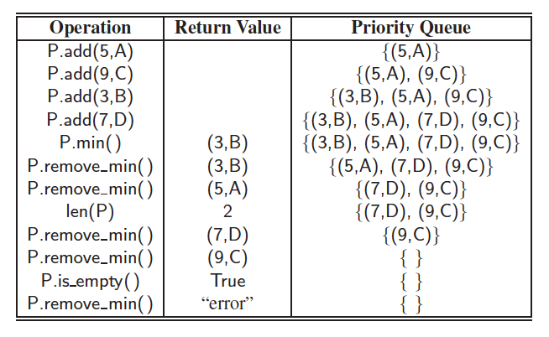
Priority Queue Example
© 2013 Goodrich, Tamassia, Goldwasser
Priority Queues

Slide 4
Total Order Relations
Keys in a priority queue can be arbitrary objects on which an order is defined
Two distinct entries in a priority queue can have the same key
Mathematical concept of total order relation ≤
  Reflexive property:
  x ≤ x
  Antisymmetric property:
  x ≤ y ∧ y ≤ x ⇒ x = y
  Transitive property:
  x ≤ y ∧ y ≤ z ⇒ x ≤ z
e.g. Alphabetical order: Define x <= y if ‘x’ is before ‘y’ in alphabetical order
© 2013 Goodrich, Tamassia, Goldwasser
Priority Queues
Notes:
In comparison, key in MAP ADT must be unique, while PQ ADT is not.
Once when we have the <= comparator defined, then we can order objects in a set by their keys.
Priority Queues

Slide 5
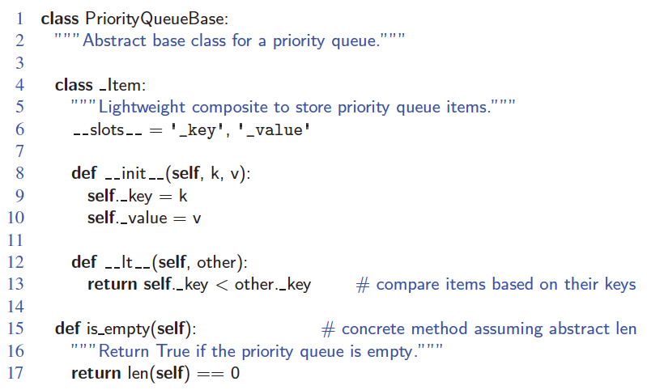
Composition Design Pattern
An item in a priority queue is simply a key-value pair
Priority queues store items to allow for efficient insertion and removal based on keys
© 2013 Goodrich, Tamassia, Goldwasser
Priority Queues
Notes:
Notice that __lt__ is defined so that two items are compared based on _key
Priority Queues

Slide 6
Sequence-based Priority Queue
Implementation with an unsorted doubly linked list
Performance:
  add takes O(1) time since we can insert the item at the beginning or end of the sequence
  Remove_min and min take O(n) time since we have to traverse the entire sequence to find the smallest key
Implementation with a sorted doubly linked list
Performance:
  add takes O(n) time since we have to find the place where to insert the item
  remove_min and min take O(1) time, since the smallest key is at the beginning
4
5
2
3
1
1
2
3
4
5
© 2013 Goodrich, Tamassia, Goldwasser
Priority Queues

Slide 7
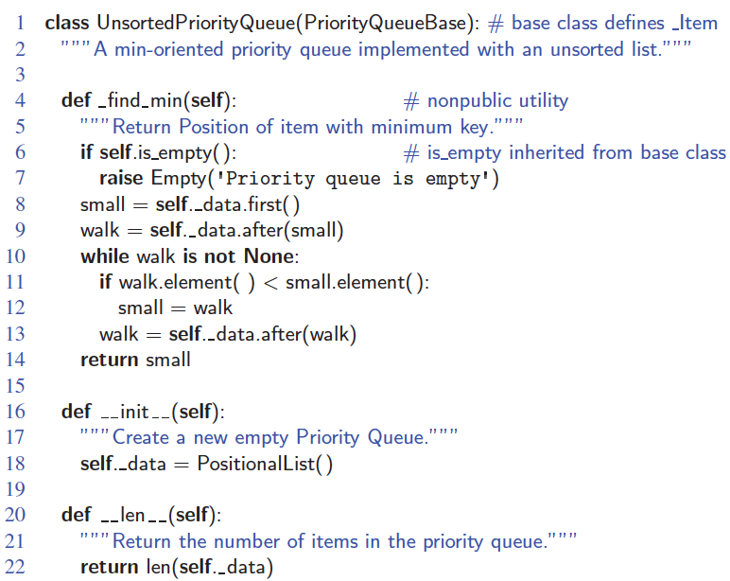
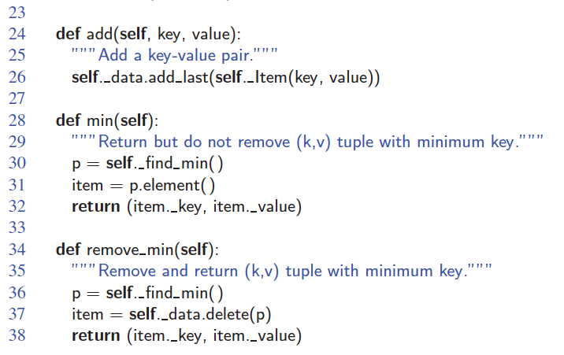
Unsorted List Implementation
© 2013 Goodrich, Tamassia, Goldwasser
Priority Queues

Slide 8
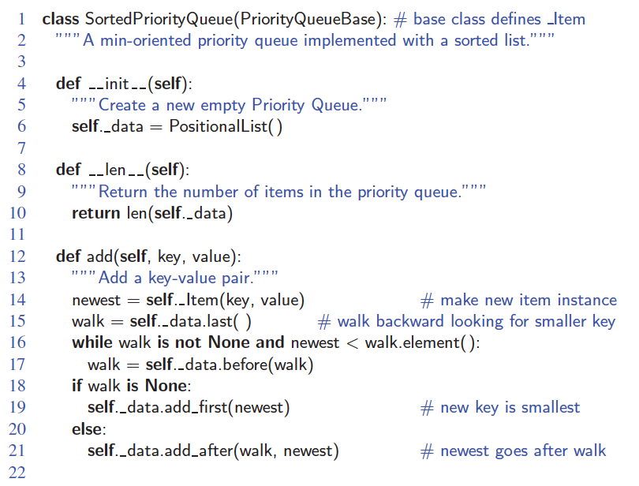
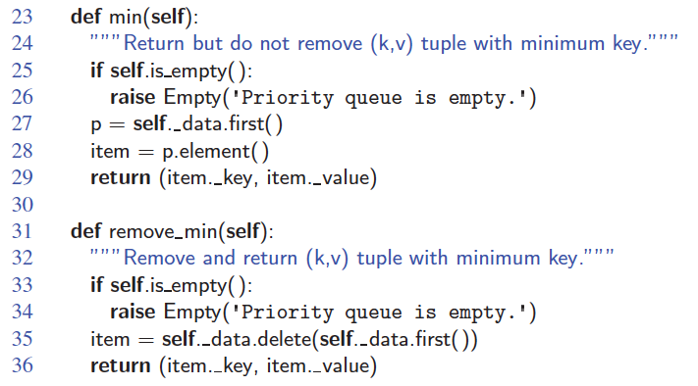
Sorted List Implementation
© 2013 Goodrich, Tamassia, Goldwasser
Priority Queues

Slide 9
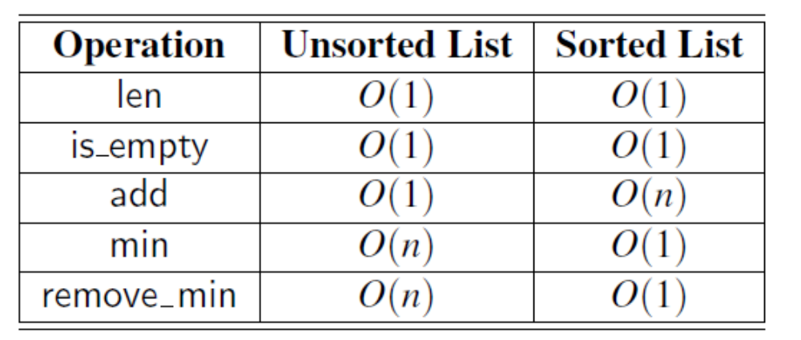
Runtime of implementing PQ using Sorted and Unsorted List
© 2013 Goodrich, Tamassia, Goldwasser
Priority Queues
Notes:
Worst-case running times of the methods of a priority queue of size n,
realized by means of an unsorted or sorted list, respectively. We assume that the
list is implemented by a doubly linked list. The space requirement is O(n).
Priority Queues

Slide 10
Priority Queue Sorting
We can use a priority queue to sort a set of comparable elements
  Insert the elements one by one with a series of add operations
  Remove the elements in sorted order with a series of remove_min operations
The running time of this sorting method depends on the priority queue implementation
Algorithm PQ-Sort(S, C)
  Input sequence S, comparator C for the elements of S
  Output sequence S sorted in increasing order according to C
  P ← priority queue with comparator C
  while ¬S.is_empty ()
  e ← S.remove_first ()
    P.add (e, ∅)
  while ¬P.is_empty()
  e ← P.removeMin().key()
    S.add_last(e)
© 2013 Goodrich, Tamassia, Goldwasser
Priority Queues

